Slide 1
UNIT-I EH

Slide 2
Introduction to foot printing
The first step of the hacking process is gathering information on a target. Information gathering, also known as footprinting, is the process of gathering all available information about an organization.
A hacker uses information-gathering techniques to determine organizations’ high-value targets, where the most valuable information resides. Not only does information gathering help identify where the information is located, but it also helps determine the best way to gain access to the targets. This information can then be used to identify and eventually hack target systems.
Social engineering can also be used to obtain more information about an organization, which can ultimately lead to an attack. Social engineering as an information-gathering tool is highly effective at exploiting the most vulnerable asset in an organization: the people. Human interaction and the willingness to give out information make people an excellent source of information.
The term reconnaissance comes from the military and means to actively seek an enemy’s intentions by collecting and gathering information about an enemy’s composition and capabilities via direct observation, usually by scouts or military intelligence personnel trained in surveillance. In the world of ethical hacking, reconnaissance applies to the process of information gathering. Reconnaissance is a catchall term for watching the hacking target and gathering information about how, when, and where they do things. By identifying patterns of behavior, of people or systems, an enemy could find and exploit a loophole.

Slide 3
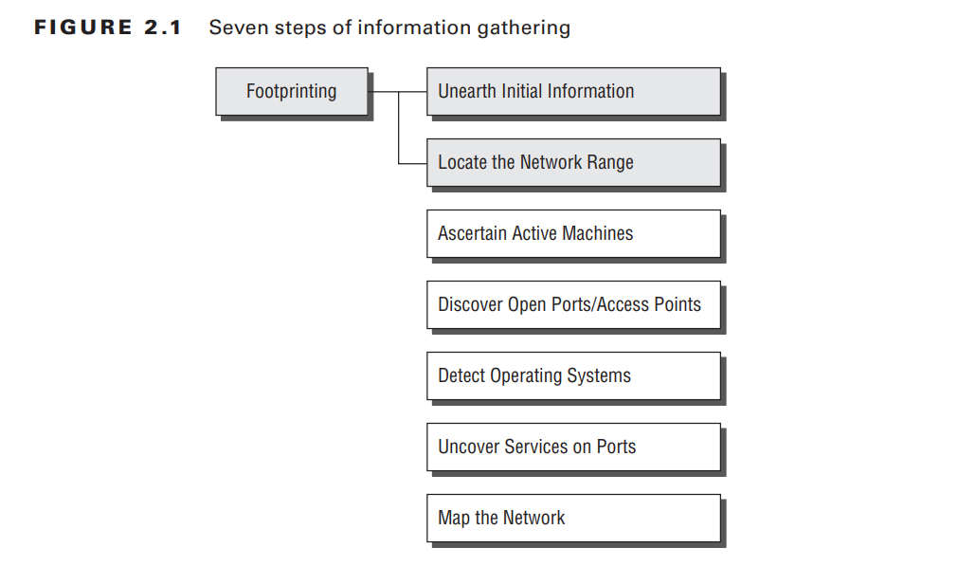
Information-Gathering Methodology
Information gathering can be broken into seven logical steps (see Figure 2.1). Footprinting is performed during the first two steps of unearthing initial information and locating the network range.

Slide 4
Footprinting
Footprinting is defined as the process of creating a blueprint or map of an organization’s network and systems. Information gathering is also known as footprinting an organization.
Footprinting begins by determining the target system, application, or physical location of the target. Once this information is known, specific information about the organization is gathered using nonintrusive methods.
For example, the organization’s own web page may provide a personnel directory or a list of employee bios, which may prove useful if the hacker needs to use a social-engineering attack to reach the objective.

Slide 5
Here are some of the pieces of information to be gathered about a target during footprinting:
Domain name
Network blocks
Network services and applications
System architecture
Intrusion detection system
Authentication mechanisms
Specific IP addresses
Access control mechanisms
Phone numbers
Contact addresses

Slide 6
Tools used for the reconnaissance
Some of the common tools used for footprinting and information gathering are as
follows:
Domain name lookup
Whois
NSlookup
Sam Spade

Slide 7
Types of Footprinting
There are two main types of footprinting: passive and active.
Passive footprinting involves collecting data without actively engaging with the target system. Under this approach, information is collected through crawling websites and social media platforms, among other methods.
For example, tools like tcpdump and Wireshark can be used to capture packets sent and received by the target system.
Active footprinting involves interacting with the target system to gather information. This can be done manually or using automated tools like Nmap and Nessus.
Active footprinting is more intrusive and can potentially cause harm to the target system if not done carefully, but it can also gather information that can’t be collected through passive footprinting.

Slide 8
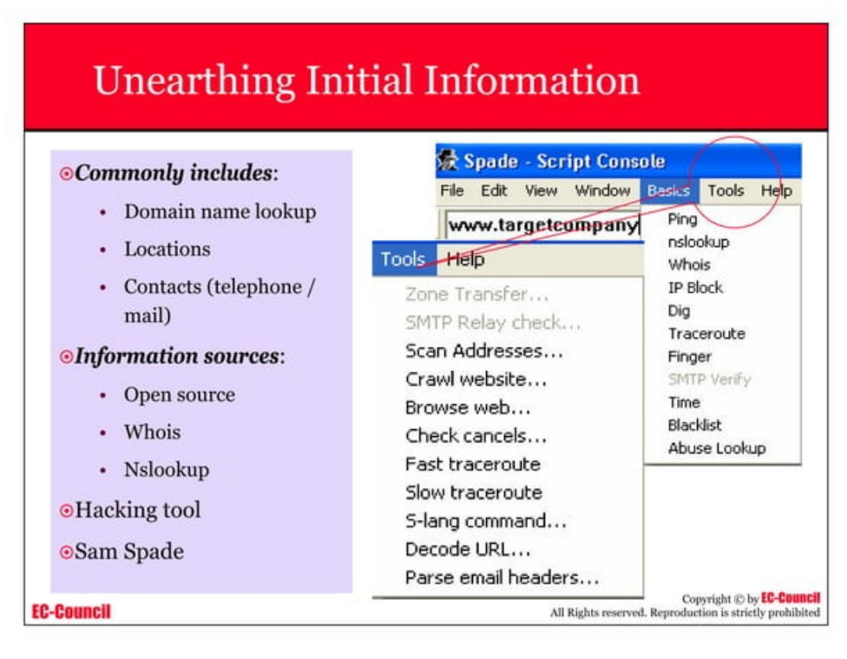

Slide 9
Footprinting a Target
Using Google to Gather Information A hacker may also do a Google search or a Yahoo! People search to locate information about employees or the organization itself.
The Google search engine can be used in creative ways to perform information gathering. The use of the Google search engine to retrieve information has been termed Google hacking. Go to http://groups.google.com to search the Google newsgroups.
Blogs, newsgroups, and press releases are also good places to find information about the company or employees. Corporate job postings can provide information as to the type of servers or infrastructure devices a company may be using on its network.
Generally, a hacker spends 90 percent of the time profiling and gathering information on a target and 10 percent of the time launching the attack.

Slide 10
Tools used for the reconnaissance
Whois is a command-line utility used in Linux systems to retrieve information about domain names, IP addresses, and network devices registered with the Internet Corporation for Assigned Names and Numbers (ICANN).
The data received by Whois consists of the name and contact information of the domain or IP address owner, the registration and expiration date, the domain registrar, and the server information.
Whois command can be very useful for network administrators, web developers, and security professionals for achieving various tasks like checking network connectivity or troubleshooting.
In this article, we will go through the usage of the Whois command on Linux (Ubuntu system).

Slide 11
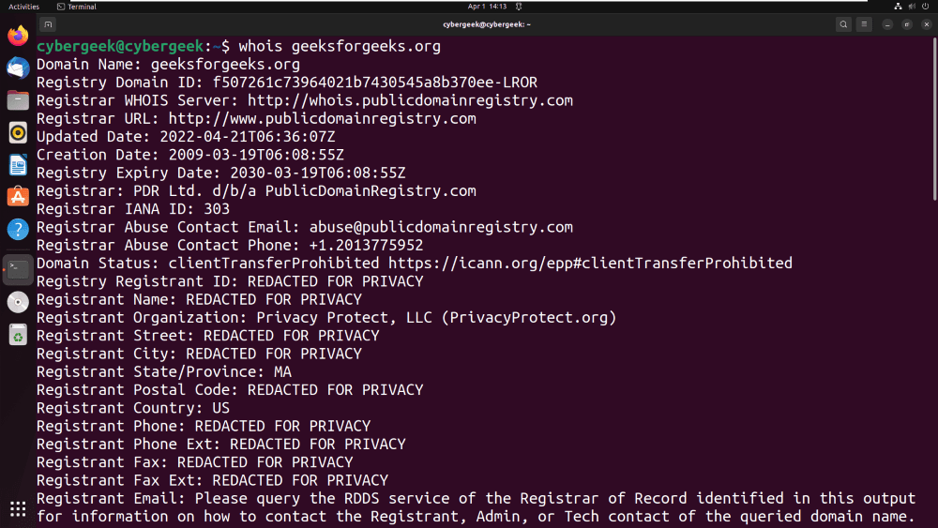

Slide 12
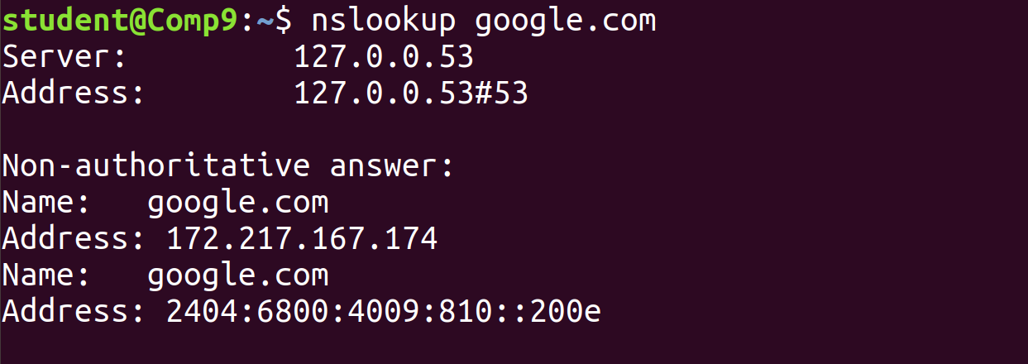
Nslookup (stands for “Name Server Lookup”) is a useful command for getting information from the DNS server. It is a network administration tool for querying the Domain Name System (DNS) to obtain domain name or IP address mapping or any other specific DNS record. It is also used to troubleshoot DNS-related problems.

Slide 13
Search Engine Footprinting
Search engine footprinting is a passive reconnaissance technique where ethical hackers use search engines to gather information about a target organization. By using advanced search operators and specialized tools, an attacker can uncover sensitive information such as admin portals, exposed directories, employee details, and confidential documents.
Techniques of Search Engine Footprinting
Using Advanced Search Operators Search engines like Google provide advanced search operators that allow users to refine their searches and extract specific information.
site:<domain> – Lists all indexed pages of a domain.
Example: site:example.com will show all pages indexed under example.com.
filetype:<extension> – Finds specific file types that may contain sensitive data.
Example: filetype:pdf site:example.com finds all PDF documents within the domain.

Slide 14
intitle:"index of" – Searches for open directory listings on web servers.
Example: intitle:"index of" "backup" may reveal backup files open to the public.
inurl:admin – Finds URLs that contain "admin", potentially leading to admin login pages.
Example: inurl:admin site:example.com might expose admin portals of the target site.
cache:<domain> – Views a cached version of a website, useful when sites remove sensitive content.
Example: cache:example.com can reveal outdated but useful information.
link:<url> – Finds pages that link to a particular URL.
Example: link:example.com shows external websites linking to the domain.

Slide 15
Suppose an attacker is looking for confidential documents in an organization. They might use:
Examples:
filetype:xls OR filetype:doc "confidential" site:example.com
This query will search for confidential Excel or Word files on the domain.
Tools for Search Engine Footprinting
Google Dorks
Google Dorking is a technique that involves using advanced search queries to extract sensitive information from publicly available sources.
Many organizations unknowingly expose configuration files, error logs, or sensitive documents indexed by search engine

Slide 16
Example Query:
inurl:wp-admin site:example.com
This query helps locate WordPress admin login pages of a target site.
Shodan
Shodan is a search engine specifically designed to find Internet of Things (IoT) devices, servers, webcams, industrial control systems, and more.
It allows ethical hackers to search for devices based on IP addresses, open ports, and software versions.
Example Query
org:"Example Inc" port:22
This finds SSH-enabled devices belonging to "Example Inc".

Slide 17
Recon-ng
Recon-ng is an open-source reconnaissance framework that automates search engine queries to gather intelligence about a target.
It integrates modules that collect email addresses, subdomains, and vulnerabilities from search engines.
Example Usage:
recon/domains-contacts/crossref
This command extracts contact information from public sources.
Output Example
Let’s assume an ethical hacker wants to find all publicly available admin panels of a target website (example.com). They might use the following query:
site:example.com inurl:admin

Slide 18
Possible Results:
https://example.com/admin/login.php
https://example.com/cms/admin/index.html
https://example.com/secure/admin/dashboard
These URLs might indicate exposed admin panels that could be further tested for vulnerabilities.
Countermeasures Against Search Engine Footprinting
Use Robots.txt
The robots.txt file can prevent search engines from indexing sensitive pages.
2. Use Authentication and Access Control
Restrict access to admin portals using proper authentication and IP whitelisting.
3. Monitor Search Engine Exposure
Organizations should regularly check what information about them is available in search engines using Google Dork queries.
4. Remove Cached Content
Use the Google Search Console to remove sensitive pages from search results.

Slide 19
Website Footprinting
What is Website Footprinting?
Website footprinting is the process of gathering information about a target website to identify potential vulnerabilities. Ethical hackers use passive and active techniques to extract details such as technologies used, website structure, comments in source code, and possible entry points
Techniques of Website Footprinting
Examining Website Source Code
Websites often contain HTML comments, JavaScript, and hidden fields that may leak sensitive information.
Attackers inspect the source code for API keys, credentials, or developer notes.
2. Extracting Metadata from Public Files
Files like PDFs and Word documents may contain metadata, revealing author names, software versions, and timestamps.
Kali Linux Tool: ExifTool
Command: exiftool filename.pdf

Slide 20
Website Mirroring
Downloading an offline copy of a website helps analyze its structure and hidden files.
Tools: HTTrack, wget.
Command: wget -r -p -U Mozilla http://example.com
Identifying CMS and Technologies
Attackers analyze the CMS and technologies used on a website.
Tools: Wappalyzer, WhatWeb.
Command: whatweb example.com
Tools for Website Footprinting in Kali Linux
Burp Suite – Captures and analyzes HTTP requests.
Nmap – Detects open ports on the webserver.
Nikto – Scans websites for vulnerabilities.
Command: nikto -h http://example.com

Slide 21
Countermeasures
Remove unnecessary metadata from files.
Disable verbose error messages.
Implement Content Security Policy (CSP)
E-mail Footprinting
What is E-mail Footprinting?
E-mail footprinting involves gathering information about an organization or individual through email headers, social engineering, and tracking mechanisms.
Techniques of E-mail Footprinting
Analyzing E-mail Headers
Email headers contain details about IP addresses, mail servers, timestamps, and routing paths.
Social Engineering Attacks
Attackers impersonate employees or executives to extract sensitive data via phishing emails.

Slide 22
Tracking E-mail Read Status
Spy Pixels or Read Receipts embedded in emails inform attackers when and where an email was opened.
Searching Leaked E-mails
Kali Linux Tool: theHarvester
Command: theHarvester -d example.com -b google
Tools for E-mail Footprinting
Email Header Analyzer – Extracts metadata from emails.
theHarvester – Gathers emails from search engines.
Hunter.io – Finds email addresses associated with a domain.
Countermeasures
Avoid disclosing email addresses publicly.
Use encrypted email services.
Disable automatic image loading.

Slide 23
DNS Footprinting
What is DNS Footprinting?
DNS (Domain Name System) footprinting is the process of collecting information about an organization's domain, subdomains, mail servers, and IP addresses.
Techniques of DNS Footprinting Using Kali Linux
WHOIS Lookup
Retrieves domain registration details like owner name and server locations.
Command: whois example.com
Finding Subdomains
Kali Linux Tool: Sublist3r
Command: sublist3r -d example.com
Zone Transfer Attack
If a DNS server is misconfigured, attackers can retrieve the complete domain structure.
Command: dig axfr @dns-server example.com
Reverse DNS Lookup
Maps an IP address back to a domain name, useful for discovering hidden services.
Command: host 192.168.1.1

Slide 24
Tools for DNS Footprinting in Kali Linux
Nslookup – Queries DNS records.
Fierce – Performs DNS enumeration.
dnstrails.com – Finds historical DNS records.
Countermeasures
Use private WHOIS registration.
Restrict DNS zone transfers.
Implement DNSSEC to prevent spoofing attacks.
Network Footprinting
What is Network Footprinting?
Network footprinting is the process of mapping an organization’s network infrastructure, live hosts, open ports, and services.

Slide 25
Techniques of Network Footprinting Using Kali Linux
Ping Sweeping
Identifies live hosts by sending ICMP echo requests.
Command: fping -g 192.168.1.0/24
Port Scanning
Identifies open ports on a target machine.
Kali Linux Tool: Nmap
Command: nmap -sS -p 1-65535 example.com
OS Fingerprinting
Detects the operating system of a target by analyzing network responses.
Command: nmap -O example.com
Banner Grabbing
Retrieves service banners that expose software versions and vulnerabilities.
Command: nc -v example.com 80
Tools for Network Footprinting in Kali Linux
Nmap – Scans ports and services.
Angry IP Scanner – Detects active devices.
Shodan – Finds internet-exposed systems.
.

Slide 26
Countermeasures
Configure firewalls to block unnecessary ports.
Disable ICMP responses to prevent ping sweeps.
Use intrusion detection systems (IDS)
HTTrack – Website Copier : It is a free utility that downloads the offline copy of any website. Offline copy includes all images, pages, links and code from original website. Using this tool, you do not have to spend much time on target website. Spending too much time on any website may cause monitoring tools to log your activity.
Understanding DNS Enumeration
DNS enumeration is the process of locating all the DNS servers and their corresponding records for an organization.
A company may have both internal and external DNS servers that can yield information such as usernames, computer names, and IP addresses of potential target systems.
NSlookup, DNSstuff, the American Registry for Internet Numbers (ARIN), and Whois can all be used to gain information that can then be used to perform DNS enumeration

